Slide 1
流水线型协议

Slide 2


Performance of rdt3.0
rdt3.0 works, but performance stinks
ex: 1 Gbps link, 15 ms prop. delay, 8000 bit packet:
U _{sender}: utilization – fraction of time sender busy sending
1KB pkt every 30 msec -> 33kB/sec thruput over 1 Gbps link
network protocol limits use of physical resources !

Slide 3
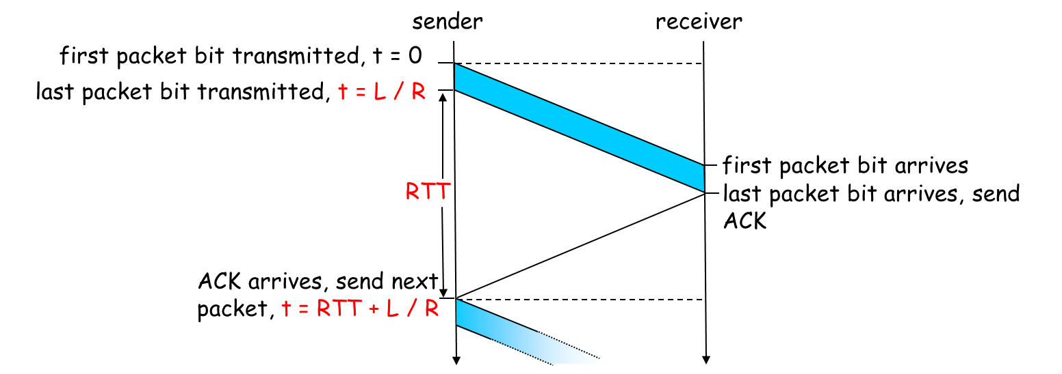
rdt3.0: stop-and-wait operation

Slide 4
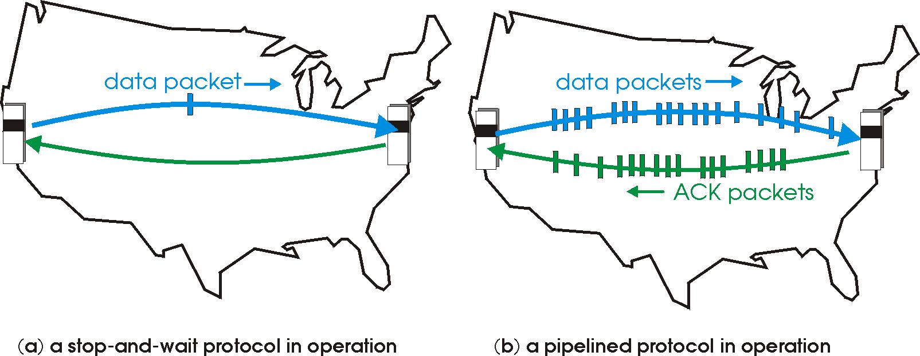
Pipelined protocols
Pipelining: sender allows multiple, “in-flight”, yet-to-be-acknowledged pkts
range of sequence numbers must be increased
buffering at sender and/or receiver
Two generic forms of pipelined protocols: go-Back-N, selective repeat

Slide 5
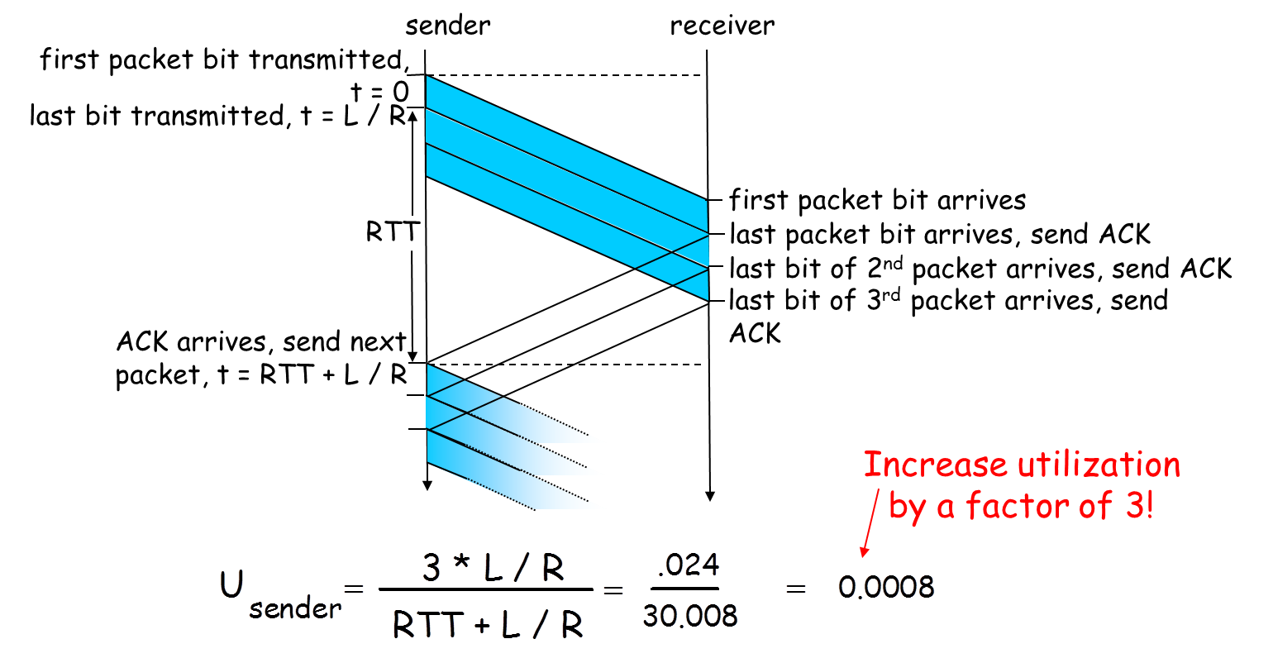
Pipelining: increased utilization

Slide 6
Pipelining Protocols
Go-back-N: big picture
Sender can have up to N unacked packets in pipeline
Rcvr only sends cumulative acks
Doesn’t ack packet if there’s a gap
Sender has timer for oldest unacked packet
If timer expires, retransmit all unacked packets
Selective Repeat: big pic
Sender can have up to N unacked packets in pipeline
Rcvr acks individual packets
Sender maintains timer for each unacked packet
When timer expires, retransmit only unack packet

Slide 7

Summary
Why pipelining?
Two pipelined protocols

